Slide 1
Data Visualization
Leslie McIntosh and Connie Zabarovskaya

Slide 2
Today You Will Learn:
What are Grammar of Graphics, GGVIS, rCharts and Shiny?
How to create an interactive plot using ggvis
Explanation
Hands-On
How to publish a ggvis plot online
Explanation
Hands-On
How to create an interactive plot in rCharts
Explanation
Hands-On
How to publish an rCharts plot online
Explanation
Hands-On
Where to get more resources, tools, etc.

Slide 3
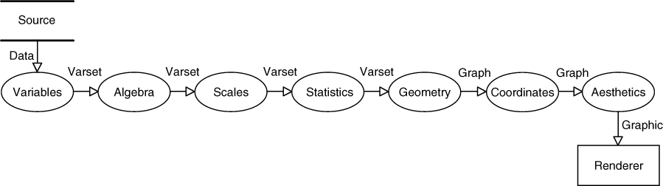
What is Grammar of Graphics?

Slide 4
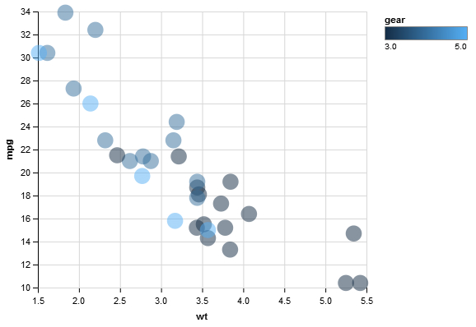
What is ggvis?
a data visualization package,
developed by Hadley Wickham
allows for interactive graphics thanks to shiny integration

Slide 5
Why & How to Use ggvis?
Data Scientist
*
Exploratory DA
Explanatory DA
End User
*
Exploratory DA
Interactive visualization tools
ggvis is great for both exploratory & explanatory data analysis
syntax is similar to ggplot2
works great with dplyr
graphics can be published online using shiny

Slide 6
Installing ggvis
Now available on CRAN: install.packages("ggvis")
or install the development package:
install.packages("devtools") devtools::install_github("rstudio/ggvis", build_vignettes = FALSE)

Slide 7
Steps with ggvis
Intro to ggvis
Some examples with ggvis
Create a ggvis plot
Integrate it with a Shiny app
Publish it on a Shiny server/shinyapps.io

Slide 8
GGVIS Data Visualization (basic)
> library(ggvis)
call to ggvis
> p<- ggvis(mtcars, x = ~wt, y = ~mpg, …)
to actually plot (display) the data
> layer_points(p)
name of plot
data set
var from data set for x-axis
var from data set for y-axis
other elements, if any

Slide 9
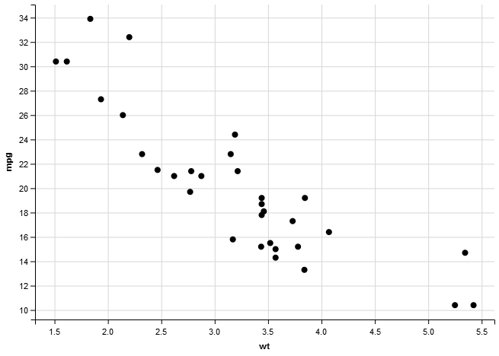
The Result

Slide 10
Adding Elements to the Plot
to avoid nested functions and“temporary” variables use %>% (termed ‘pipe’)
%>% takes value on the left-hand side and passes it to function or expression on the right-hand side
FYI: Pipe comes from the magrittr package (http://cran.r-project.org/web/packages/magrittr/magrittr.pdf)
Data set
ggvis() call
plot call
pipe
into
pipe
into

Slide 11
Adding Elements to the Plot
> mtcars %>%
ggvis(x = ~wt, y = ~mpg) %>%
layer_points()
OR
> mtcars %>%
ggvis(~wt, ~mpg) %>%
layer_points()
Data set
ggvis() call
plot call
pipe
into
pipe
into

Slide 12
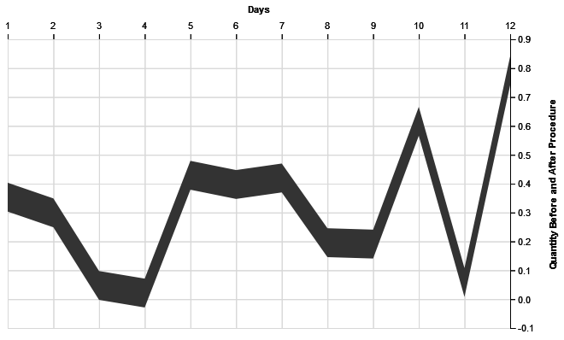
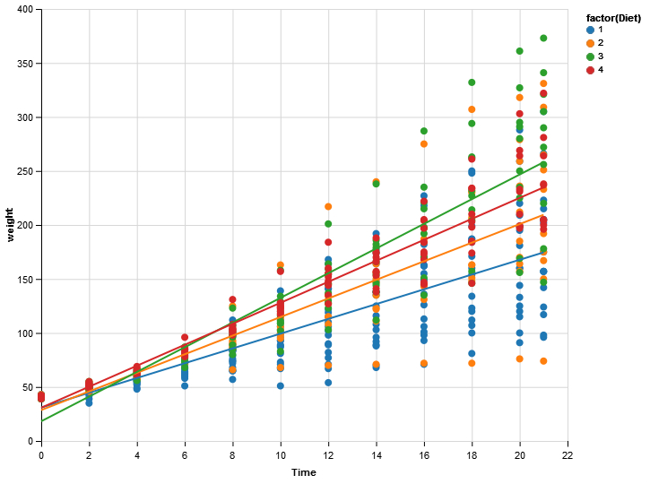
Some Examples
> df <- data.frame(x = 1:12, y = runif(12))
df %>% ggvis(x = ~x, y = ~y, y2 = ~y - 0.1) %>% layer_ribbons() %>%
add_axis("x", title = "Days", orient = "top") %>%
add_axis("y", title = "Quantity Before and After Procedure", orient = "right", title_offset = 50)
> ChickWeight %>%
ggvis(x = ~Time, y = ~weight, fill = ~factor(Diet)) %>%
layer_points() %>%
group_by(Diet) %>%
layer_model_predictions(model="lm", stroke = ~factor(Diet))

Slide 13
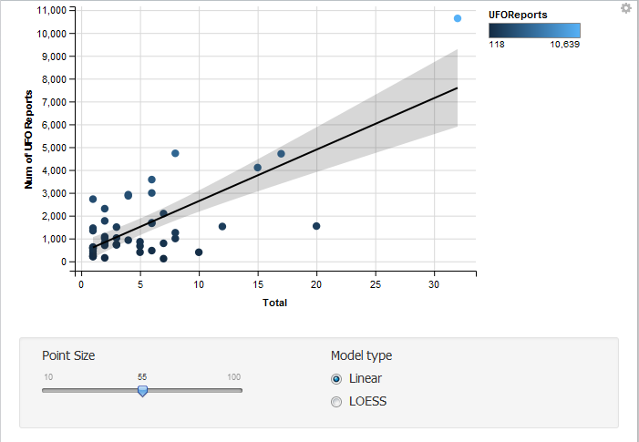
Hands-On Example
Copy and paste the code from:
http://rpubs.com/conniez/datavis
if(!file.exists("./data")){dir.create("./data")}
reportsUrl <- "https://github.com/ConnieZ/ufo_app/raw/master/data/ufo_reports.csv"
download.file(reportsUrl, destfile="./data/ufo_reports.csv", mode="wb")
milbaseUrl <- "https://github.com/ConnieZ/ufo_app/raw/master/data/milbases.csv"
download.file(milbaseUrl, destfile="./data/milbases.csv", mode="wb")
milbases <- read.csv("data/milbases.csv")
reports <- read.csv("data/ufo_reports.csv")
mergeddata <- merge(reports, milbases, by="State")

Slide 14
Hands-On Example
Copy and paste the code from:
http://rpubs.com/conniez/datavis
mergeddata %>%
ggvis( ~Total, ~UFOReports) %>%
layer_points(fill = ~UFOReports, size := input_slider(10, 100, label = "Point Size")) %>%
layer_model_predictions(model = input_radiobuttons( choices = c("Linear" = "lm", "LOESS" = "loess"), selected = "lm",
label = "Model type"), se = TRUE) %>%
add_axis("y", title = "Num of UFO Reports", orient = "left", title_offset = 50)

Slide 15
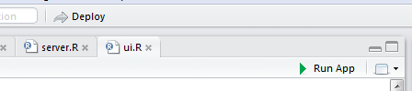
GGVIS Publishing Online
You can publish your charts online using Shiny functionality. Add the script to a Shiny app and publish the app. Example here: http://ggvis.rstudio.com/interactivity.html#shiny-apps
See good demo here: https://github.com/rstudio/ggvis/tree/master/demo/apps/basic
Steps:
Create ui.R and server.R files for a Shiny app in a certain folder (folder name = short name of your app). Add data files in a folder inside of it
From Rstudio test your application by clicking “Run App” button in your text editor window of Rstudio.
If you have set up your Rstudio with access to Shiny or Shinyapps.io, you will also see the “Deploy” button to publish it online.
Another option:
runApp(“myapp”)
library(shinyapps)
deployApp(“myapp”)

Slide 16
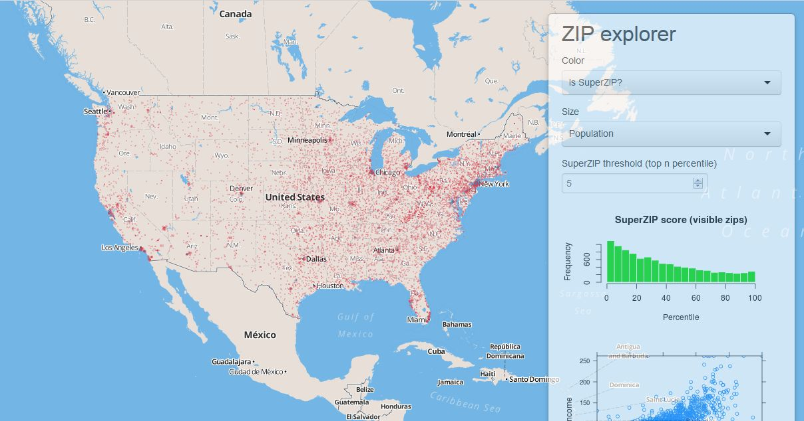
Shiny Interactive Graphics
Shiny is a web application framework for R, which allows you to create interactive web apps.
Shiny can be used with any plotting tool in R
Shiny Tutorial: http://shiny.rstudio.com/tutorial/lesson1/
Shiny Cheatsheet: http://shiny.rstudio.com/articles/cheatsheet.html
You can create Shiny apps by copying and modifying existing Shiny apps.

Slide 17
Shiny Online Publishing (web page)
Shiny Server and Shiny Server Pro are currently only supported on Linux. They provide 64-bit binary installers for Ubuntu/Debian and Red Hat/CentOS.
You can host your apps in the cloud for free with ShinyApps.io. Just create an account and link to your computer. There are some performance and memory limitations.

Slide 18
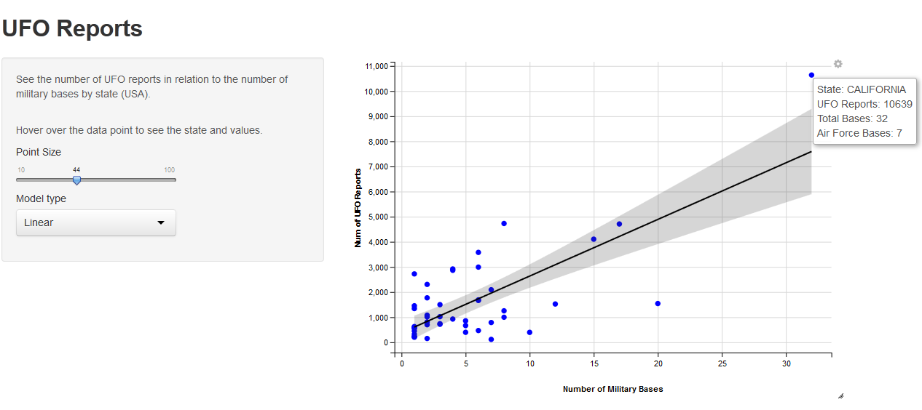
Let’s Publish the GGVIS Plot Online
See details: http://rpubs.com/conniez/datavis
Steps:
Create an app folder in wd and copy the data folder into the app folder
Reconstruct the code for server.R and ui.R and save them into the app folder
Publish the app on shinyapps.io or shiny server

Slide 19
More Options with GGVIS
Interactive Controls available:
input_slider(),
input_select() (dropdown menu)
input_checkbox(),
input_checkboxgroup() (multiple choice),
input_radiobuttons(),
input_text() and input_numeric() (only numerical input),
Use “=“ when assigning interactive controls to a var, “:=“ is used only for static values
Other layer options, besides layer_points() and layer_histograms():
layer_bars()
layer_ribbons() (filled space between two paths or a path and an axis)
layer_paths() (all points connected with a line)
layer_lines() (equivalent to arrange(x) %>% layer_paths())
layer_smooths() (displays predictions with a line)
layer_rects() (rectangles)
layer_text() (displays text on the chart)
To display multiple layers on one chart – pipe (%>%) them into each other, but include individual parameters (fill, size, span, etc.) inside their parentheses, instead of ggvis()

Slide 20
Some More Resources on GGVIS
http://ggvis.rstudio.com/cookbook.html
http://ggvis.rstudio.com/interactivity.html

Slide 21
More Resources
Links to examples and tutorials on Slidify, rCharts, Shiny, etc.: http://www.r-bloggers.com/fantastic-presentations-from-r-using-slidify-and-rcharts/
100 interesting data sets: http://rs.io/2014/05/29/list-of-data-sets.html
Google Dataset Engine: https://www.google.com/cse/publicurl?cx=002720237717066476899:v2wv26idk7m
Missouri Data: https://data.mo.gov/

Slide 22
Thank you!
Questions?

